Slide 1
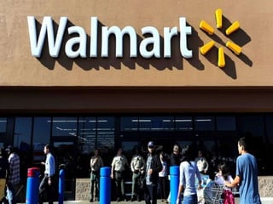
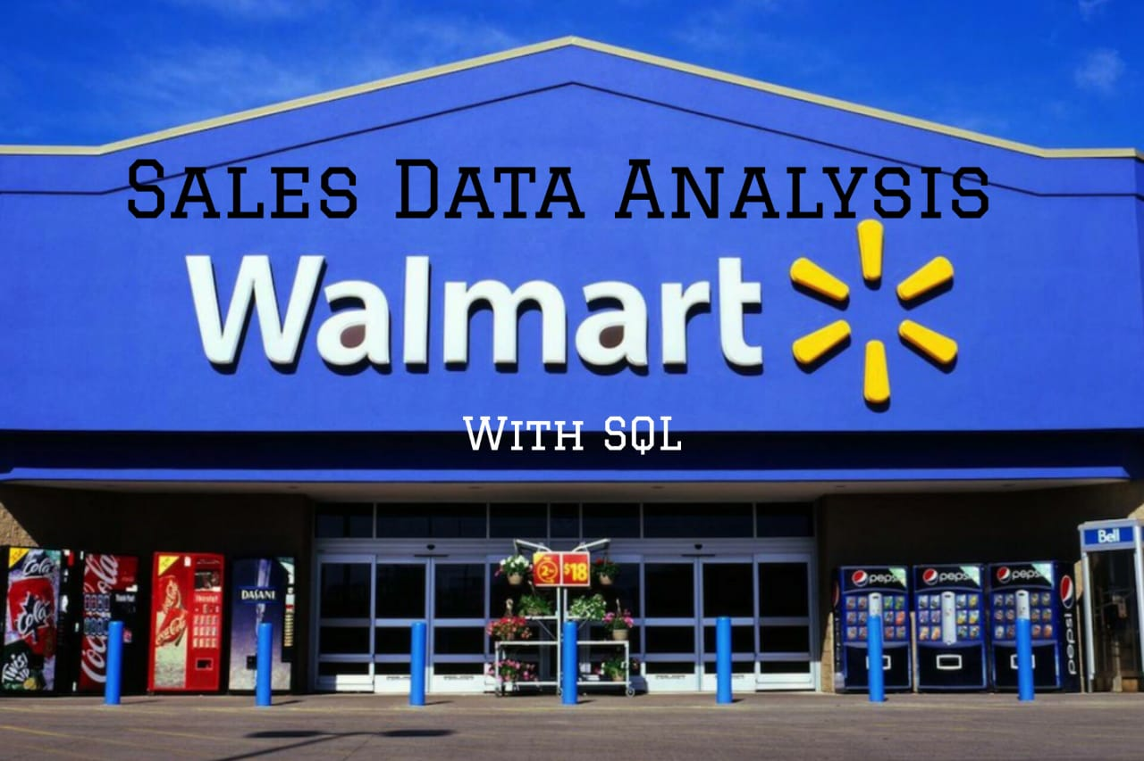

Sales Data Analysis With SQL
BY : KARTHIKEYAN R

Slide 2
AGENDA
1.Introduction
2.Purpose
3.About Data
4.Analysis List
5.Approach Used
6.Feature Engineering
7.Bussiness Questions
8.Key Insights
9.Recommendations

Slide 3
Introduction
This project aims to explore the Walmart sales data to understand top-performing branches and products, sales trends of different products, and customer behavior.
The aims is to study how sales strategies can be improved and optimized. The dataset was obtained from the Kaggle Walmart Sales Forecasting Competition.
The historical sales data for 45 Walmart stores located in different regions. Each store contains many departments, and the challenge involves selected holiday markdown events are included in the dataset. These markdowns are known to affect sales, but it is challenging to predict which departments are affected and the extent of the impact. source

Slide 4
Purpose
The major aim of this project is to gain insight into the sales data of Walmart to understand the different factors that affect sales of the different branches.
It also helps to understand customer’s taste, preference and their purchasing items.
With these insights, management can make informed decisions that will drive business growth.

Slide 5
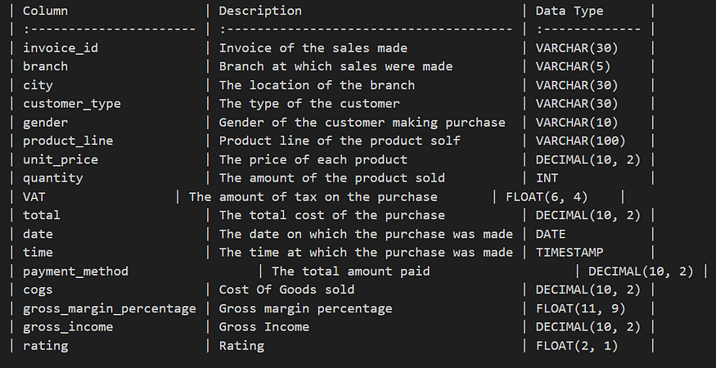
About data
This dataset contains sales transactions from a three different branches of Walmart, respectively located in Mandalay, Yangon and Naypyitaw. The data contains 17 columns and 1000 rows…

Slide 6
Analysis list
1.Product Analysis - Conduct analysis on the data to understand the different product lines, the products lines performing best and the product lines that need to be improved.
2.Sales Analysis - This analysis aims to answer questions about the sales trends of products. The results can help measure the effectiveness of each sales strategy the business applies and what modifications are needed to gain more sales.
3.Customer Analysis - This analysis aims to uncover the different customers segments, purchase trends and the profitability of each customer segment.

Slide 7

Approach used
1.Data Wrangling - This is the first step where inspection of data is done to make sure NULL values and missing values are detected and data replacement methods are used to replace, missing or NULL values.
Build a database

Slide 8
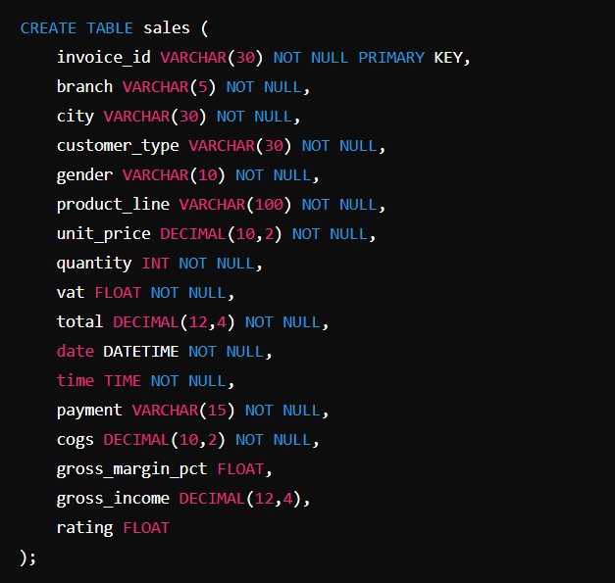
Approach used
Create a table and insert the data
There are no null values in our database because we set NOT NULL for each field when creating the tables, thereby filtering out any null values.

Slide 9
Feature EnGINEERING
The following step involves generating new columns from the existing ones.
Add a new column named `time of day` to give insight of sales in the Morning, Afternoon and Evening. This will help answer the question on which part of the day most sales are made.
Introduce a new column named `day name` that contains the extracted days of the week on which the given transaction took place (Mon, Tue, Wed, Thu, Fri). This will help answer the question on which week of the day each branch is busiest.
Generate a new column named `month name` that contains the extracted months of the year on which the given transaction took place (Jan, Feb, Mar). Help determine which month of the year has the most sales and profit.

Slide 10
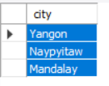

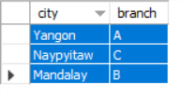

Business Questions
Generic Question :
1. What are the unique cities does the data have ?
2. In Which city is each branch located ?

Slide 11
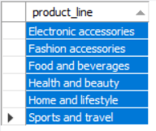



Business Questions
Product Analysis :
1. What are the unique product lines does the data have?
2. What is the most common payment method?

Slide 12
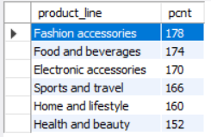



Business Questions
Product Analysis :
3. What is the most selling product line?
4. What is the total revenue by month?

Slide 13


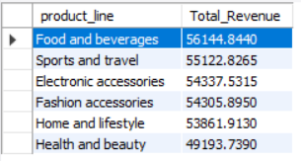

Business Questions
Product Analysis :
5. Which month had the highest COGS?
6. Which product line had the largest revenue?

Slide 14
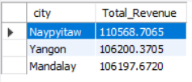

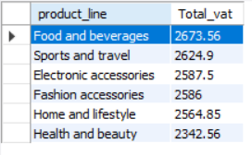

Business Questions
Product Analysis :
7. What is the city with the largest revenue?
8. What product line had the largest VAT?

Slide 15
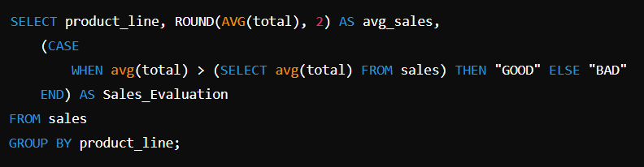
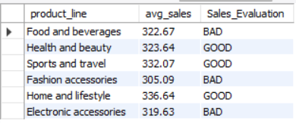

Business Questions
Product Analysis :
9. Fetch each product line and add a column to those product line showing "Good", "Bad". Good if its greater than average sales?
10. Which branch sold more products than average product sold?

Slide 16
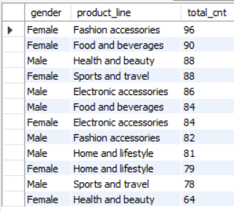
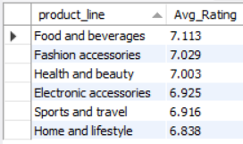

Business Questions
Product Analysis :
11. What is the most common product line by gender?
12. What is the average rating of each product line?

Slide 17
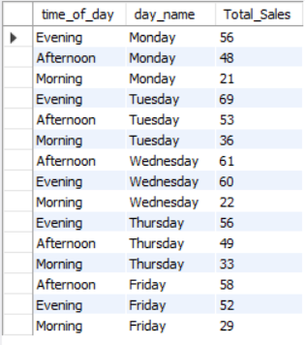
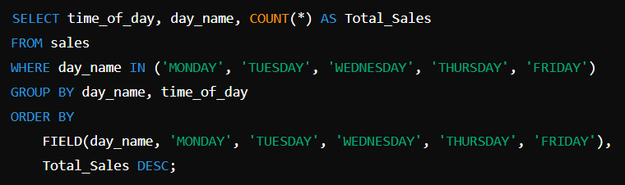


Business Questions
Sales Analysis :
1. Number of sales made in each time of the day per weekday?
2. Which of the customer types brings the most revenue?

Slide 18
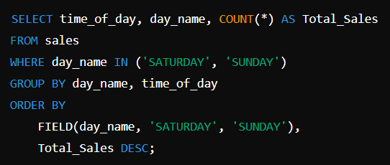
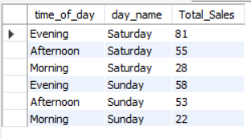

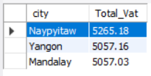
Business Questions
Sales Analysis :
3. Number of sales made in each time of the day per weekend?
4. Which city has the largest tax percent / VAT (Value Added Tax) ?

Slide 19


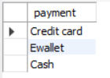



Business Questions
Customer Analysis :
1. How many unique customer types does the data have?
2. How many unique payment methods does the data have?
3. What is the most common customer type?

Slide 20
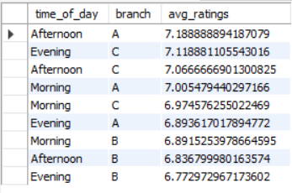
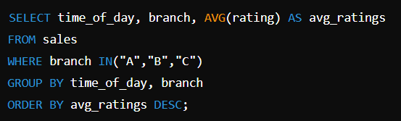
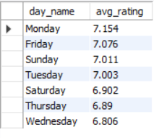
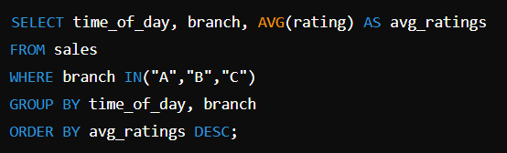
Business Questions
Customer Analysis :
4. Which time of the day do customers give most ratings per branch?
5. Which day of the week has the best avg ratings?

Slide 21
Key insights
1.Females predominantly purchase fashion accessories, while males lead in the purchase of Healthy and beauty. This indicates distinct consumer behavior based on gender.
2.The Food and Beverages category has the highest average customer rating, which suggests that customers are highly satisfied with these products.
3.Sales peak in the evening across most weekdays. This pattern suggests that customers prefer shopping later in the day.
4.Weekend sales, especially on Saturday evenings, are significantly higher, indicating more leisure and shopping activity during weekends.
5.The distribution between members and normal customers is almost even, with members slightly outnumbering normal customers. This shows a balanced mix in the customer loyalty program.
6.Certain products have higher sales on specific days, for example, "Home and Lifestyle" products have the highest average VAT, indicating higher tax rates which may correlate with higher-priced items or luxury goods.

Slide 22
Recommendations
Based on the data analysis and the SQL queries, here are some recommendations for Walmart's sales strategy:
Targeted Marketing Strategies: Develop targeted marketing campaigns for gender-specific products. Increase marketing efforts for fashion accessories aimed at females and health and beauty aimed at males.
Enhance Food and Beverage Experience: Given the high customer satisfaction in the Food and Beverages category, consider expanding these offerings or promoting this line more aggressively to capitalize on its popularity.
Promotional Timing: Implement targeted promotions during peak sales times, especially in the evenings and on weekends, to maximize customer turnout and sales. Consider morning promotions or special offers to boost sales during these lower periods, especially on Tuesdays and Thursdays when there are slight increases in sales.
Customer Loyalty Programs: Since there is a good balance of members and non-members, enhance the loyalty program to convert more normal customers into members. Offer exclusive deals or loyalty points for purchases during off-peak hours to balance the sales distribution throughout the day.
Inventory and Pricing Strategy: Reassess the pricing and inventory strategy for the "Home and Lifestyle" category due to its lower customer ratings. Collect more detailed customer feedback to understand the dissatisfaction and adjust product offerings accordingly.

Slide 23
Thank YOU
Thank you for your time and attention. If you have any questions or would like to discuss further, please connect with me on LinkedIn.
BY : KARTHIKEYAN R

